Slide 1

2 chronicles 8:1 – 11:23
A CD of this message will be available (free of charge immediately following today's message
This message will be available via podcast later this week at calvaryokc.com

Slide 2
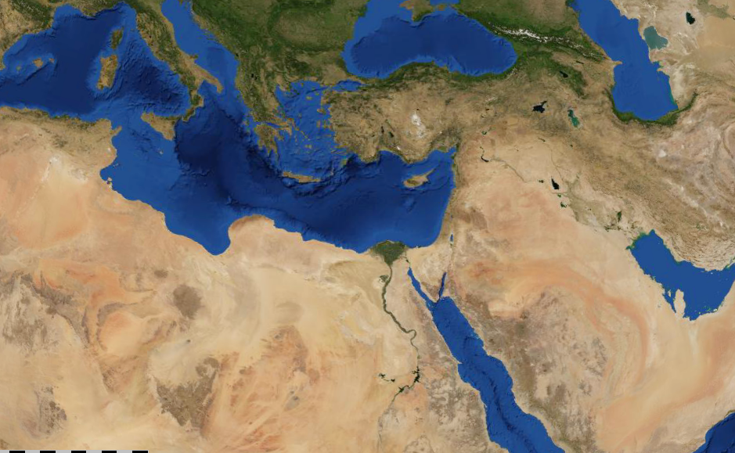
2 chronicles 8:1 – 11:23
Hamath
Beth Horon
Tadmor
Elath
Ophir

Slide 3
2 chronicles 8:1 – 11:23
Deut. 17:14-17 ~ ¹⁴ When you come to the land which the LORD your God is giving you, and possess it and dwell in it, and say, ‘I will set a king over me like all the nations that are around me,’ ¹⁵ you shall surely set a king over you whom the LORD your God chooses; one from among your brethren you shall set as king over you; you may not set a foreigner over you, who is not your brother. ¹⁶ But he shall not multiply horses for himself, nor cause the people to return to Egypt to multiply horses, for the LORD has said to you, ‘You shall not return that way again.’ ¹⁷ Neither shall he multiply wives for himself, lest his heart turn away; nor shall he greatly multiply silver and gold for himself.

Slide 4
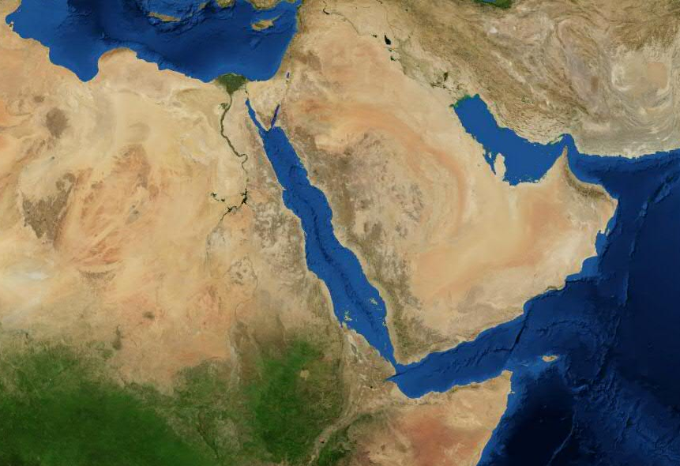
2 chronicles 8:1 – 11:23
Jerusalem
Sheba?

Slide 5
2 chronicles 8:1 – 11:23
Scourges ~ literally scorpions (as in KJV, NASB, NIV)

Slide 6
2 chronicles 8:1 – 11:23
Demons ~ sa'yir – NASB, satyrs

